Slide 1
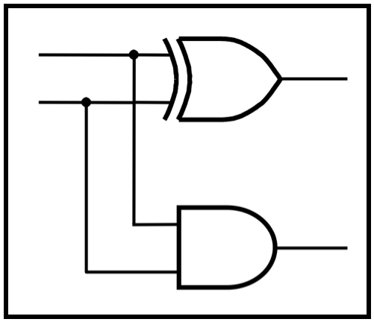
CprE 281:
Digital Logic
Instructor: Alexander Stoytchev
http://www.ece.iastate.edu/~alexs/classes/

Slide 2
Examples of Solved Problems
CprE 281: Digital Logic
Iowa State University, Ames, IA
Copyright © Alexander Stoytchev

Slide 3
Administrative Stuff
No homework is due next week.

Slide 4
Administrative Stuff
Midterm Exam #1
When: Friday Sep 23.
Where: This classroom
What: Chapter 1 and Chapter 2 plus number systems
The exam will be open book and open notes (you can bring up to 3 pages of handwritten notes).

Slide 5
Topics for the Midterm Exam
Binary Numbers
Octal Numbers
Hexadecimal Numbers
Conversion between the different number systems
Truth Tables
Boolean Algebra
Logic Gates
Circuit Synthesis with AND, OR, NOT
Circuit Synthesis with NAND, NOR
Converting an AND/OR/NOT circuit to NAND circuit
Converting an AND/OR/NOT circuit to NOR circuit
SOP and POS expressions

Slide 6
Topics for the Midterm Exam
Mapping a Circuit to Verilog code
Mapping Verilog code to a circuit
Multiplexers
Venn Diagrams
K-maps for 2, 3, and 4 variables
Minimization of Boolean expressions using theorems
Minimization of Boolean expressions with K-maps
Incompletely specified functions (with don’t cares)
Functions with multiple outputs

Slide 7
Example 1
Determine if the following equation is valid

Slide 8
?

Slide 9
?
LHS
RHS

Slide 10

Left-Hand Side (LHS)

Slide 11
Left-Hand Side (LHS)

Slide 12
Left-Hand Side (LHS)

Slide 13
Right-Hand Side (RHS)

Slide 14
Right-Hand Side (RHS)

Slide 15
Right-Hand Side (RHS)

Slide 16

?
LHS
RHS

Slide 17
Example 2
Design the minimum-cost product-of-sums expression for the function
f(x₁, x₂, x₃) = Σ m(0, 2, 4, 5, 6, 7)

Slide 18



Minterms and Maxterms
(with three variables)
[ Figure 2.22 from the textbook ]

Slide 19
Minterms and Maxterms
(with three variables)
The function is
1 for these rows

Slide 20
Minterms and Maxterms
(with three variables)
The function is
1 for these rows
The function is
0 for these rows

Slide 21
Two different ways to specify the same function f of three variables
f(x₁, x₂, x₃) = Σ m(0, 2, 4, 5, 6, 7)
f(x₁, x₂, x₃) = Π M(1, 3)

Slide 22


The POS Expression
f(x₁, x₂, x₃) = Π M(1, 3)
= M₁• M₃
= ( x₁ + x₂ + x₃)•( x₁ + x₂ + x₃)

Slide 23
The Minimum POS Expression
f(x₁, x₂, x₃)
= ( x₁ + x₂ + x₃)•( x₁ + x₂ + x₃)
= ( x₁ + x₃ + x₂)•( x₁ + x₃ + x₂)
= ( x₁ + x₃ )
Hint: Use the following Boolean Algebra theorem

Slide 24
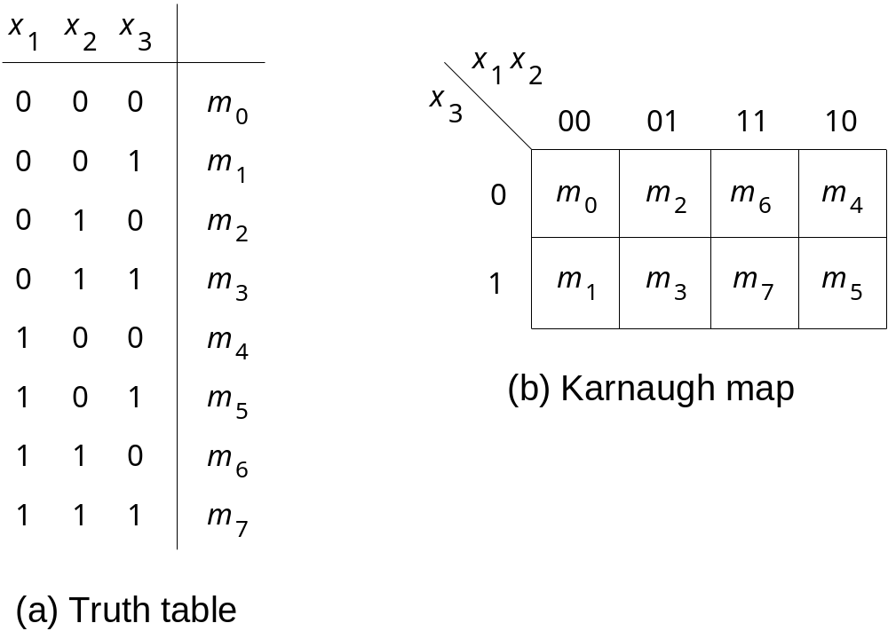
Alternative Solution Using K-Maps

Slide 25
Alternative Solution Using K-Maps

Slide 26
Alternative Solution Using K-Maps

Slide 27
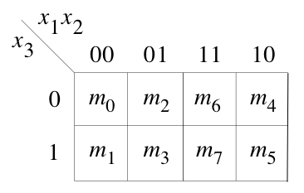
Alternative Solution Using K-Maps

Slide 28
Alternative Solution Using K-Maps
1
1
1
1
0
0
1
1

Slide 29
Alternative Solution Using K-Maps
1
1
1
1
0
0
1
1
( x₁ + x₃ )

Slide 30
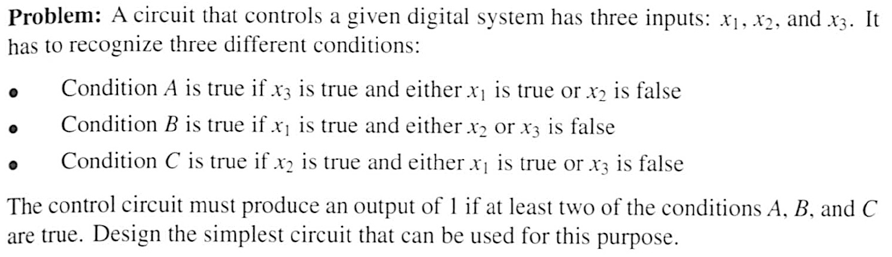
Example 3

Slide 31
Condition A

Slide 32

Condition A

Slide 33
Condition B

Slide 34

Condition B

Slide 35
Condition C

Slide 36

Condition C

Slide 37
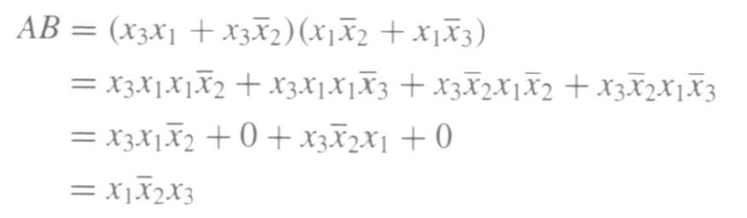
The output of the circuit can be expressed as f = AB + AC + BC

Slide 38
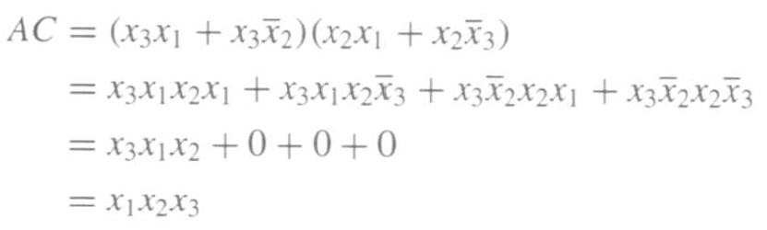
The output of the circuit can be expressed as f = AB + AC + BC

Slide 39
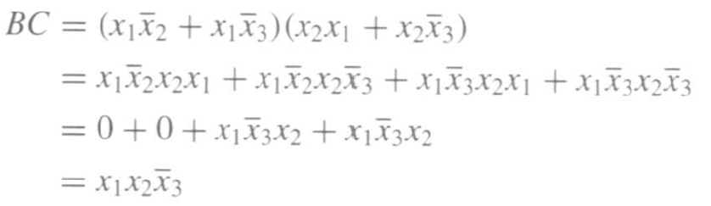
The output of the circuit can be expressed as f = AB + AC + BC

Slide 40
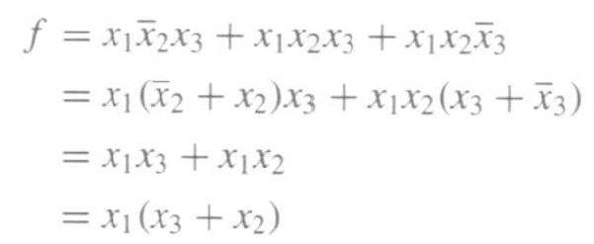
Finally, we get

Slide 41
Example 4
Solve the previous problem using Venn diagrams.

Slide 42
Venn Diagrams
(find the areas that are shaded at least two times)
x₁
x₂
x₁
x₂
x₃
x₃
(a) Function
A
(b) Function
B
x₁
x₂
x₁
x₂
x₃
x₃
(c) Function
C
(d) Function
f
[ Figure 2.66 from the textbook ]

Slide 43
Example 5
Design the minimum-cost SOP and POS
expression for the function
f(x₁, x₂, x₃, x₄) = Σ m(4, 6, 8, 10, 11, 12, 15) + D(3, 5, 7, 9)

Slide 44
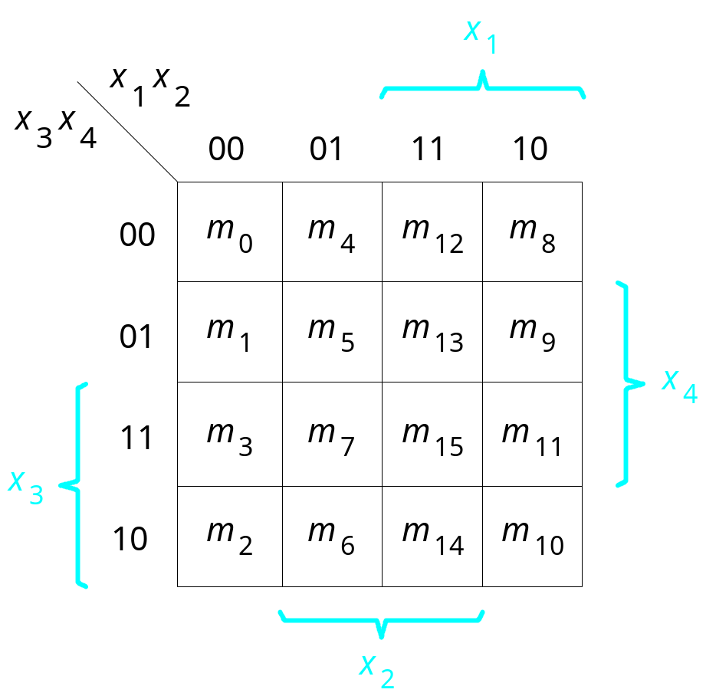
Let’s Use a K-Map
f(x₁, x₂, x₃, x₄) = Σ m(4, 6, 8, 10, 11, 12, 15) + D(3, 5, 7, 9)

Slide 45
Let’s Use a K-Map
f(x₁, x₂, x₃, x₄) = Σ m(4, 6, 8, 10, 11, 12, 15) + D(3, 5, 7, 9)
0
1
1
1
0
d
0
d
d
d
1
1
0
1
0
1

Slide 46
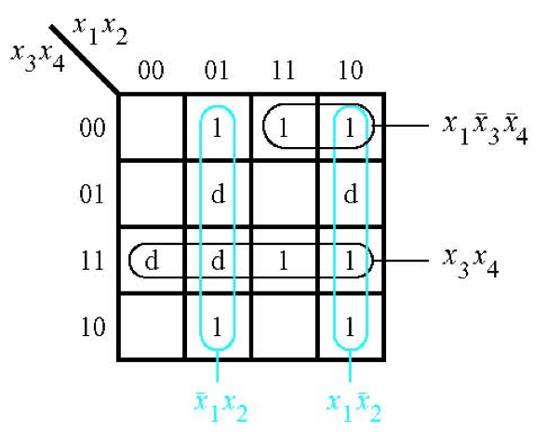
The SOP Expression
[ Figure 2.67a from the textbook ]

Slide 47
What about the POS Expression?
f(x₁, x₂, x₃, x₄) = Σ m(4, 6, 8, 10, 11, 12, 15) + D(3, 5, 7, 9)
0
1
1
1
0
d
0
d
d
d
1
1
0
1
0
1

Slide 48
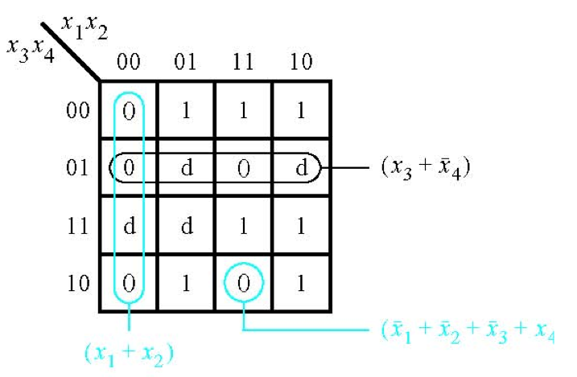
The POS Expression
[ Figure 2.67b from the textbook ]

Slide 49
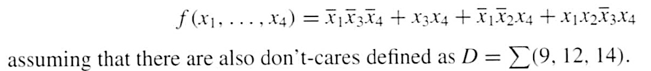
Example 6
Use K-maps to find the minimum-cost SOP and POS
expression for the function

Slide 50

Let’s map the expression to the K-Map

Slide 51
Let’s map the expression to the K-Map
d
d
d

Slide 52
Let’s map the expression to the K-Map
d
d
d

Slide 53
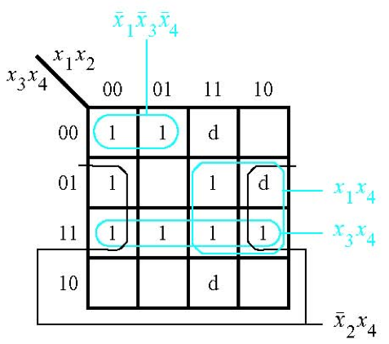

The SOP Expression
[ Figure 2.68a from the textbook ]

Slide 54
What about the POS Expression?
1
1
d
0
1
0
1
d
1
1
1
1
0
0
d
0

Slide 55
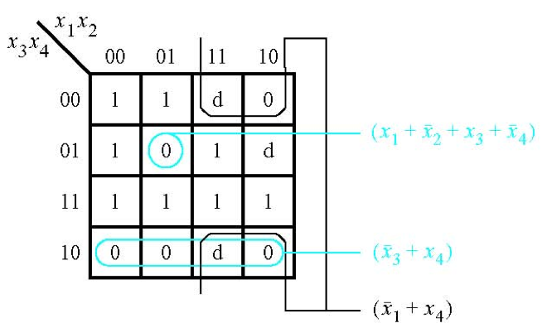

The POS Expression
[ Figure 2.68b from the textbook ]

Slide 56

Example 7
Derive the minimum-cost SOP expression for

Slide 57

First, expand the expression using property 12a

Slide 58

Construct the K-Map for this expression
s₁ s₂ s₃
s₁ s₂
s₃

Slide 59
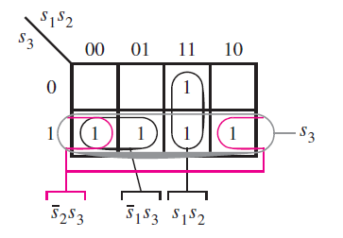
Construct the K-Map for this expression
[ Figure 2.69 from the textbook ]

Slide 60
Example 8
Write the Verilog code for the following circuit …

Slide 61
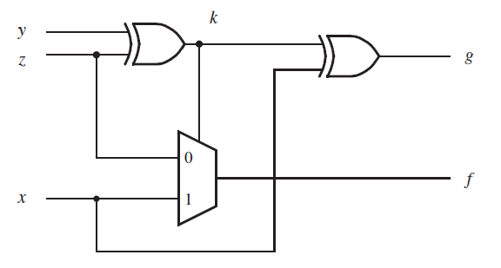
Logic Circuit
[ Figure 2.70 from the textbook ]

Slide 62
Circuit for 2-1 Multiplexer
x
s
1
f
x
1
0
f
s
x
2
1
x
2
(b) Circuit
(c) Graphical symbol
f (s, x_{1,} x₂) =
s x₁
+
s x₂
[ Figure 2.33b-c from the textbook ]

Slide 63
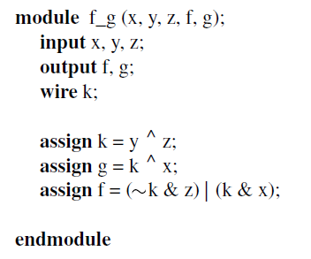
Logic Circuit vs Verilog Code
[ Figure 2.70 from the textbook ]
[ Figure 2.71 from the textbook ]

Slide 64
Example 9
Write the Verilog code for the following circuit …

Slide 65
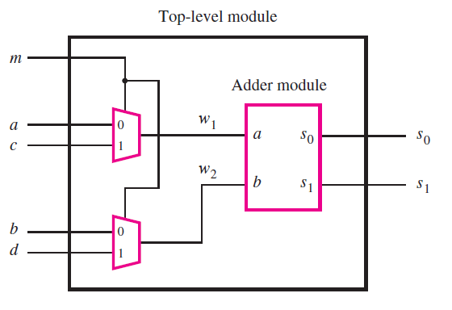
The Logic Circuit for this Example
[ Figure 2.72 from the textbook ]

Slide 66
Circuit for 2-1 Multiplexer
x
s
1
f
x
1
0
f
s
x
2
1
x
2
(b) Circuit
(c) Graphical symbol
f (s, x_{1,} x₂) =
s x₁
+
s x₂
[ Figure 2.33b-c from the textbook ]

Slide 67
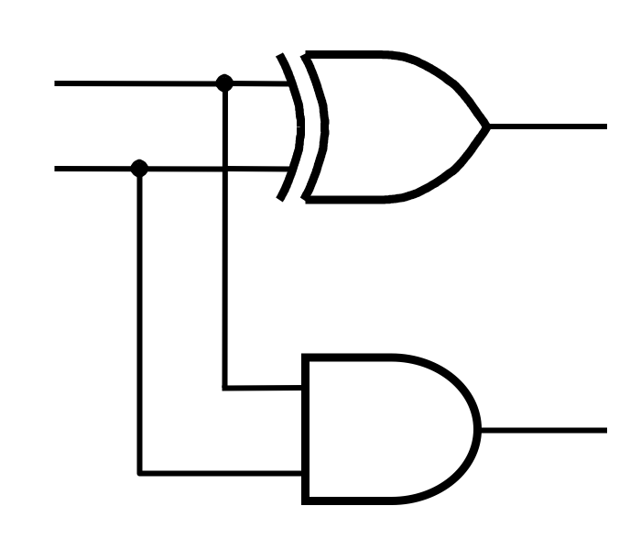
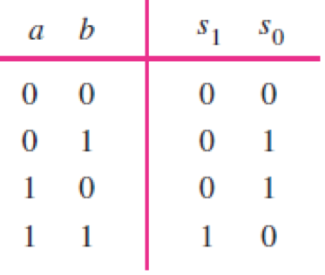
Addition of Binary Numbers

Slide 68
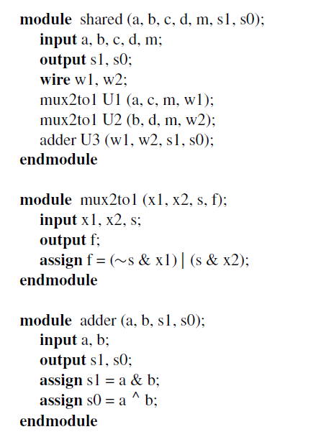
Logic Circuit vs Verilog Code
[ Figure 2.73 from the textbook ]

Slide 69
Some material form Appendix B

Slide 70
Programmable Logic Array (PLA)
x
1
x
2
x
n
Input buffers
and
inverters
x
1
x
1
x
n
x
n
P
1
AND plane
OR plane
P
k
f
f
1
m
[ Figure B.25 from textbook ]

Slide 71
Gate-Level Diagram of a PLA
x
1
x
2
x
3
Programmable
connections
OR plane
P
1
P
2
P
3
P
4
AND plane
f
1
f
2
[ Figure B.26 from textbook ]

Slide 72
Customary Schematic for PLA
x
1
x
2
x
3
OR plane
P
1
P
2
P
3
P
4
AND plane
f
f
1
2
[ Figure B.27 from textbook ]

Slide 73
Programmable Array Logic (PAL)
x
1
x
2
x
3
P
1
f
1
P
2
P
3
f
2
P
4
AND plane
[ Figure B.28 from textbook ]

Slide 74
Programmable Array Logic (PAL)
x
1
x
2
x
3
P
1
f
1
P
2
P
3
f
2
P
4
AND plane
Only the AND plane is programmable.
The OR plane is fixed.
[ Figure B.28 from textbook ]

Slide 75
Questions?

Slide 76
THE END

